Slide 1
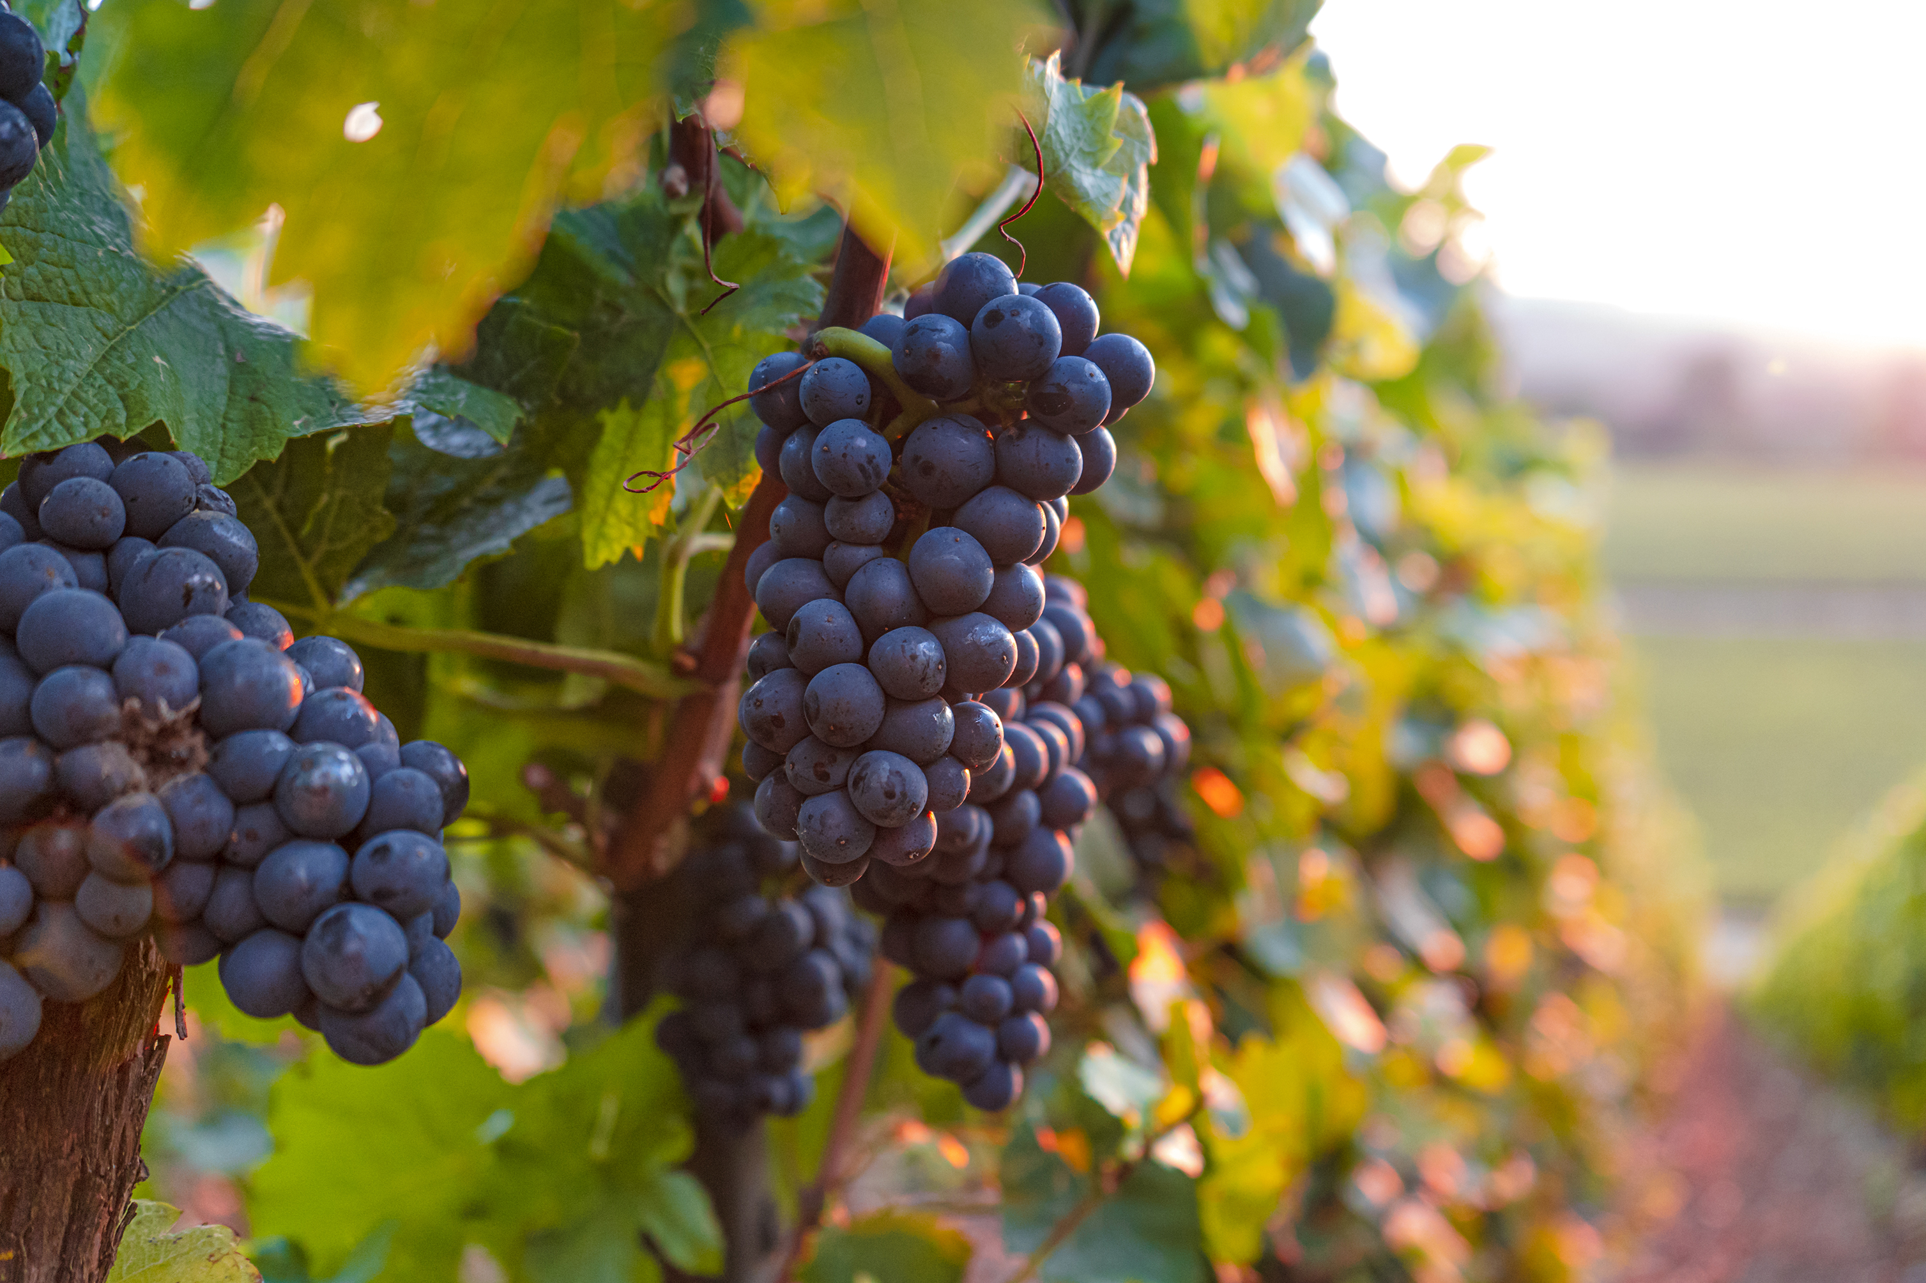
Bacchus winery
Eric Jarman
Ronnie Maggard
Jenny Rosero
Anani Vossah

Slide 2
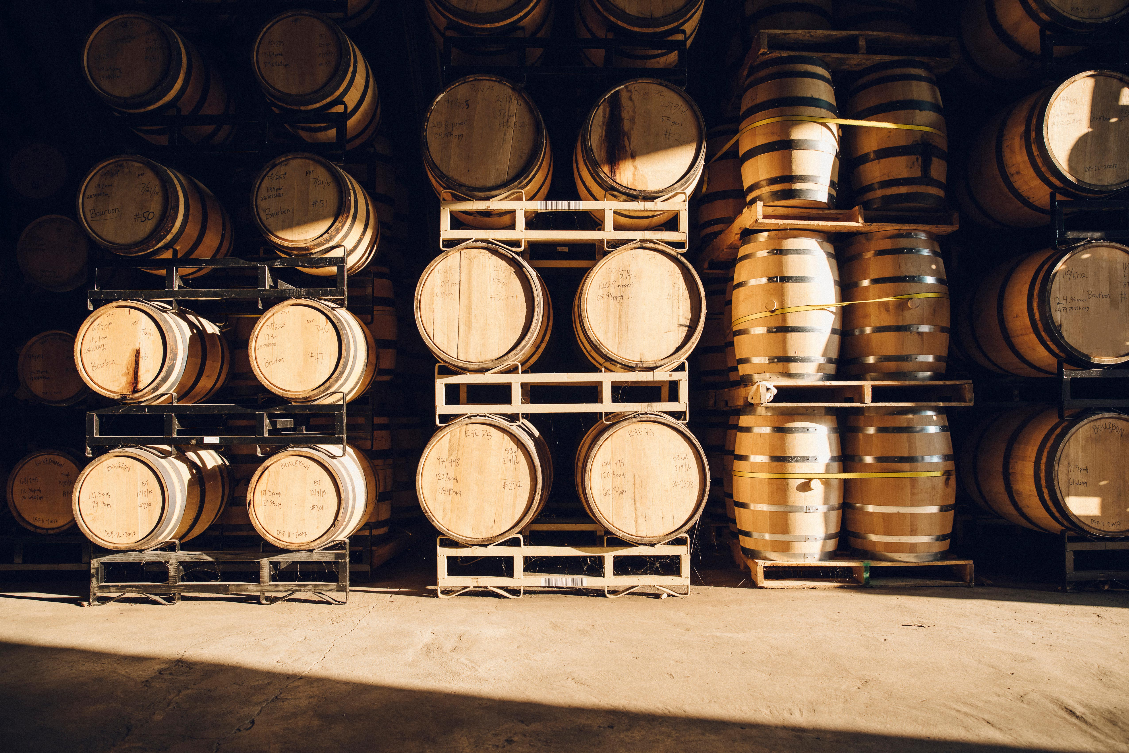

Introduction
Bacchus Winery is a family-owned winery that makes Merlot, Cabernet, Chablis, and Chardonnay. The new owners, Stan and Davis Bacchus, wish to continue their father's legacy and continue to run a successful winery. To do this they need to continue to improve their products and customer service. The database will help them in doing so. It will help answer the following questions:
"Are all suppliers delivering on time? Is there a large gap between expected delivery and actual delivery?"
"Are all wines selling as they thought? Is one wine not selling? Which distributor carries which wine?"
"During the last four quarters, how many hours did each employee work?"

Slide 3
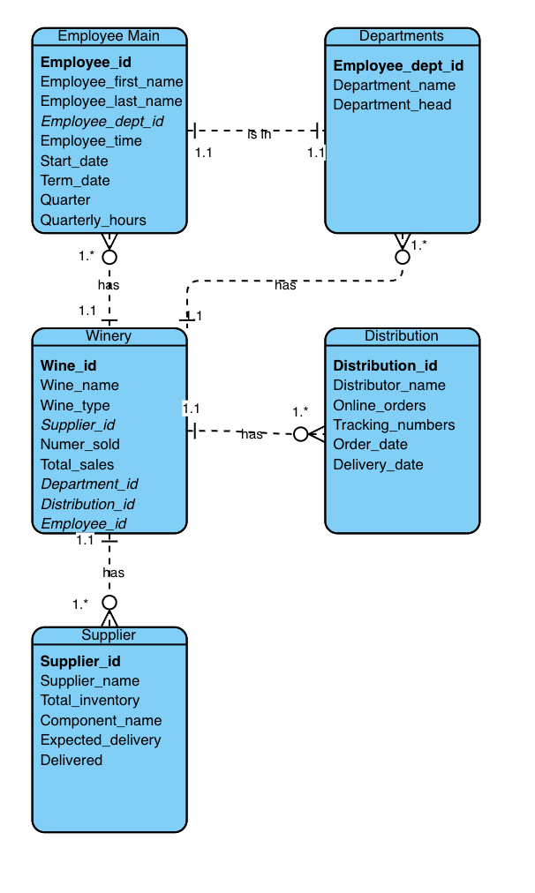
Finalized ERD

Slide 4
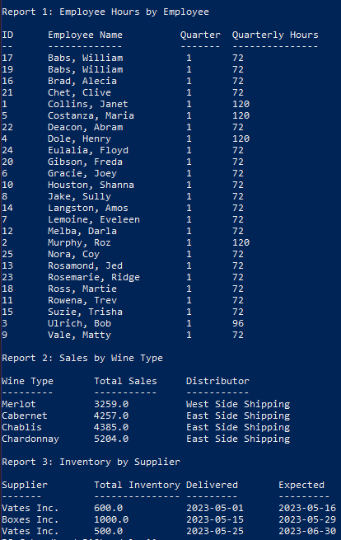
Employee Report
In the Employee Hours report, we found that the highest number of hours worked in the first quarter was 120 hours. They were worked by Janet Collins, Roz Murphey, Henry Dole, and Maria Costanza. The lowest number of hours worked was 72 hours. 20 of the 25 employees worked 72 hours.

Slide 5
Wine Report
In the Wine Sales report, we found Merlot has the lowest total sales of $3,259. This wine is distributed by West Side Shipping. Chardonnay is the most sold wine with total sales of $5,204. Our main distributor for this wine is East Side Shipping.

Slide 6
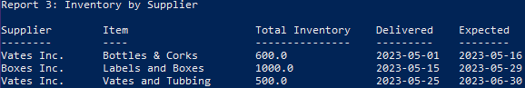
Supplier Report
The Wine Supplier report shows that for the month of May, Vates Inc and Boxes Inc delivered the supplies earlier than the expected delivery date. These are the main suppliers, and they are not showing any problem areas so far.

Slide 7
Assumptions
The winery produces four types of wines: merlot, cabernet, Chablis, and chardonnay.
The winery has four key departments: finance and payroll, marketing, production, and distribution.
The winery has a total of 25 employees, 27 if you include the Bacchus brothers.
They have three key suppliers, each delivering six different wine-making components every month or so.
Maria, in charge of distribution, would like distributors to be able to order online and track shipments. This will make dealings with the winery much more convenient for the distributors.
The owners need information on wine distribution and which distributor carries each type of wine. This will help determine which distributor is the most effective at selling each wine as well as provide data to adjust marketing strategies.

Slide 8
Assumptions Cont.
The owners need information on employee time worked in the last four quarters. This will be helpful in determining employee productivity and identifying issues with attendance.
Those in charge of keeping track of supply inventory need to be able to have an efficient way of tracking inventory and ordering more supplies.
The owners need to be able to keep track of supply delivery dates to see who delivers supplies most effectively so that they can continue to work with suppliers or find more efficient suppliers.

Slide 9

Thank you
Eric Jarman
Ronnie Maggard
Jenny Rosero
Anani Vossah

